Slide 1
PISTON COMPRESSOR DRIVEN BY A MOVING MAGNET ACTUATOR
driving coil
back iron
compressor housing
magnet rings
moving yoke
magnet holder
piston sleeve
cylinder sleeve
rear cover
seal
screws
swivel-ball set screw
copper seal
stationary magnet rings
compression chamber
transfer line

Slide 2
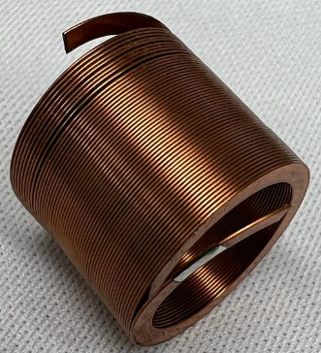
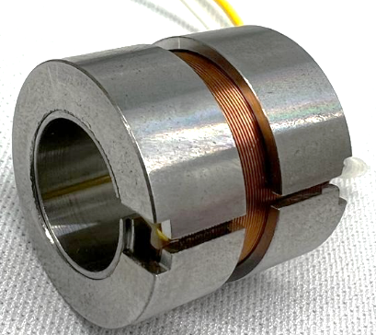
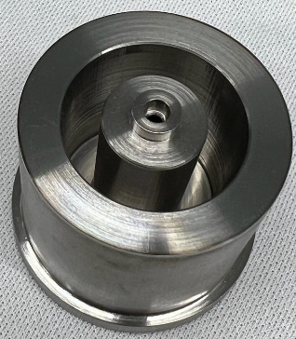
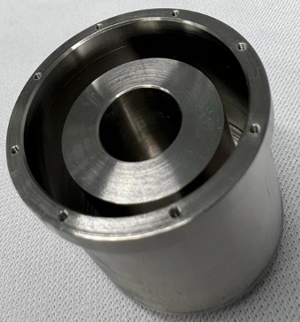
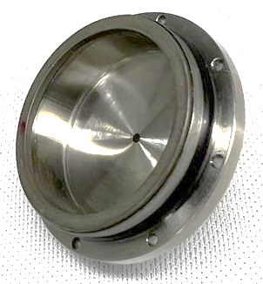
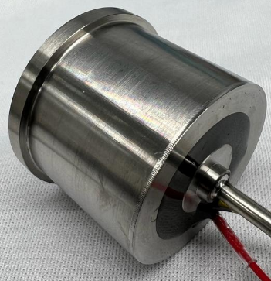
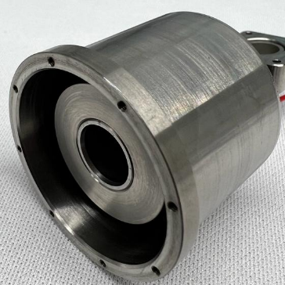
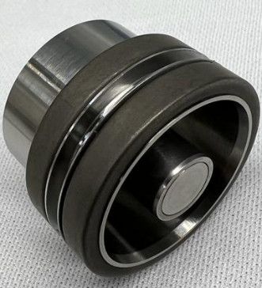
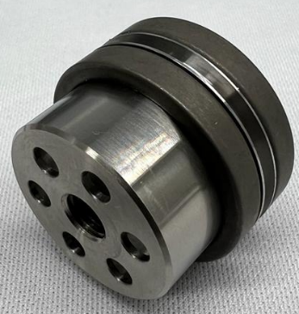
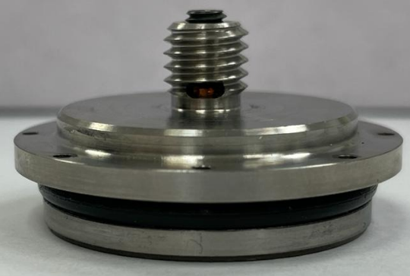
PISTON COMPRESSOR DRIVEN BY A MOVING MAGNET ACTUATOR

Slide 3
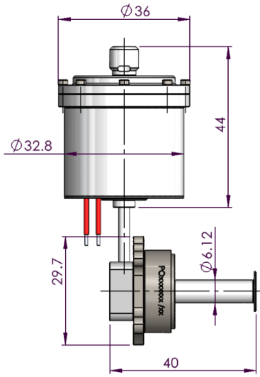
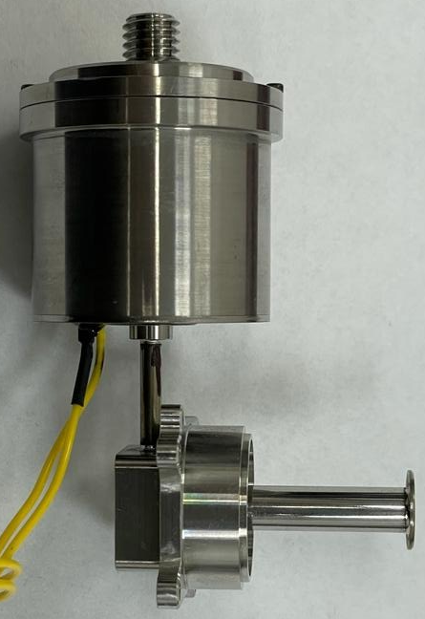
MECHANICAL DESIGN OF SPLIT LINEAR CRYOCOOLER
Weight – 115 gr (cold finger excl)

